Slide 1
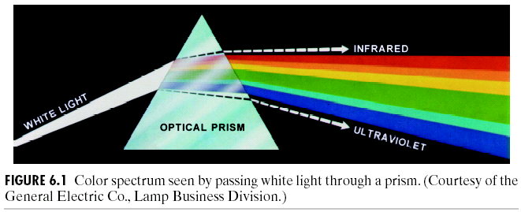
Color Image Processing
Color Fundamentals:
When a beam of sunlight passes through a glass prism, the emerging beam of light is not white but consists instead of a continuous spectrum of colors ranging from violet at one end to red at the other.

Slide 2
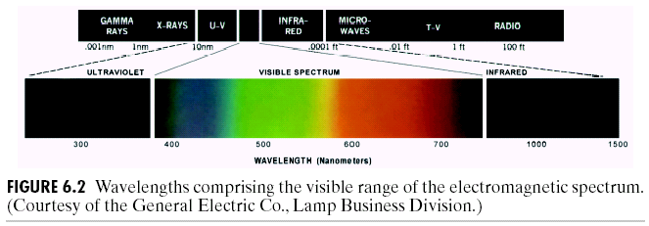
Color Image Processing

Slide 3
Color Image Processing

Slide 4
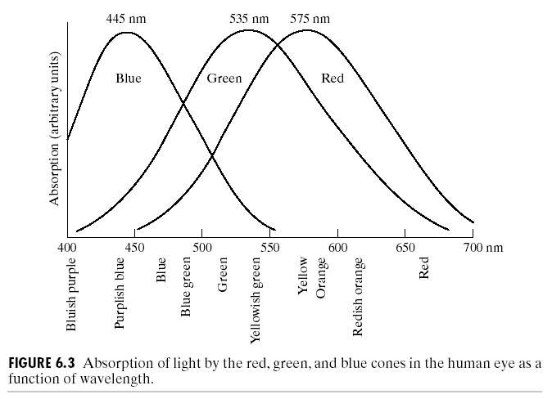
Color Image Processing

Slide 5
Color Image Processing

Slide 6
Color Image Processing

Slide 7
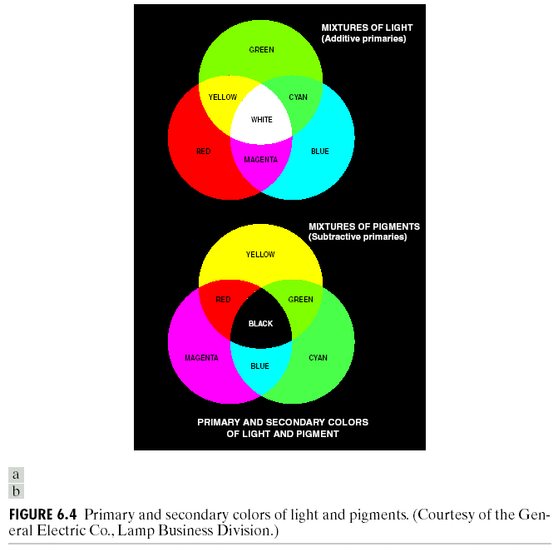
Color Image Processing

Slide 8
Color Image Processing

Slide 9
Color Image Processing

Slide 10
Color Image Processing

Slide 11
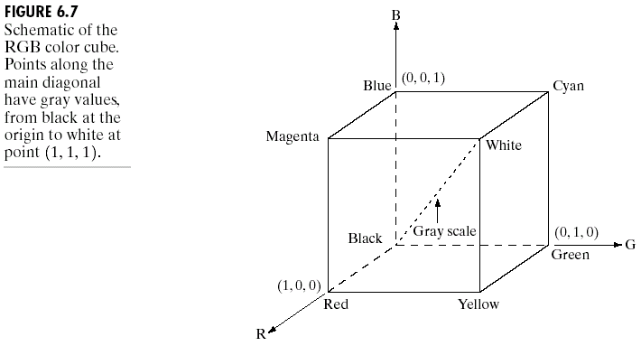
Color Image Processing
Color Models:

Slide 12
Color Image Processing
Color Models:
Most color models are used – i) Hardware oriented (color monitors and printers)
ii) applications oriented (color graphics for animations)

Slide 13
Color Image Processing
RGB Color Model:

Slide 14
Color Image Processing
RGB Color Model:
So, RGB color pixel is said to have a depth of 24 bits ( 3 image planes times the number of bits per plane).
The term full-color image is used often to denote a 24-bit RGB color image.

Slide 15
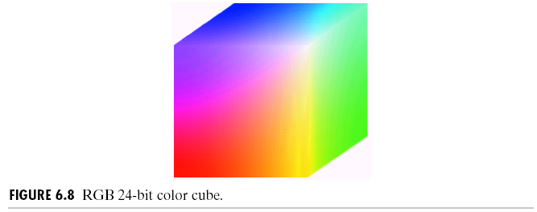
Color Image Processing

Slide 16
Color Image Processing
We will also study the following topics
The CMY and CMYK Colors Models
The HSI Color Model
Converting colors from RGB to HIS
Converting colors from HSI to RGB
Basics of Full Color Image Processing
Color Transformations
Formulations
Histogram Processing

Slide 17
Color Image Processing
Color Image smoothing
Color Image sharpening

